Slide 1
Syllabus of Embedded System
Unit 6: Peripherals and Interfacing (4 Hrs)
6.1 Sensor Interfacing: Analog and Digital Sensors (eg. Temperature, humidity, motion)
6.2 Actuator Interfacing
Motor Control (DC, Stepper, Servo)
PWM for controlling brightness, speed etc
6.3 Display Interfacing:
LCD, and Seven Segment Displays

Slide 2
Sensor Interfacing: Analog and Digital Sensors
A device that detects changes in an environment and converts them into electrical signals.
Analog sensors provide a continuous output signal proportional to measured quantity.
Analog signals requires signal conditioning. They are susceptible to noise and EMI (electromagnetic Interference).

Slide 3
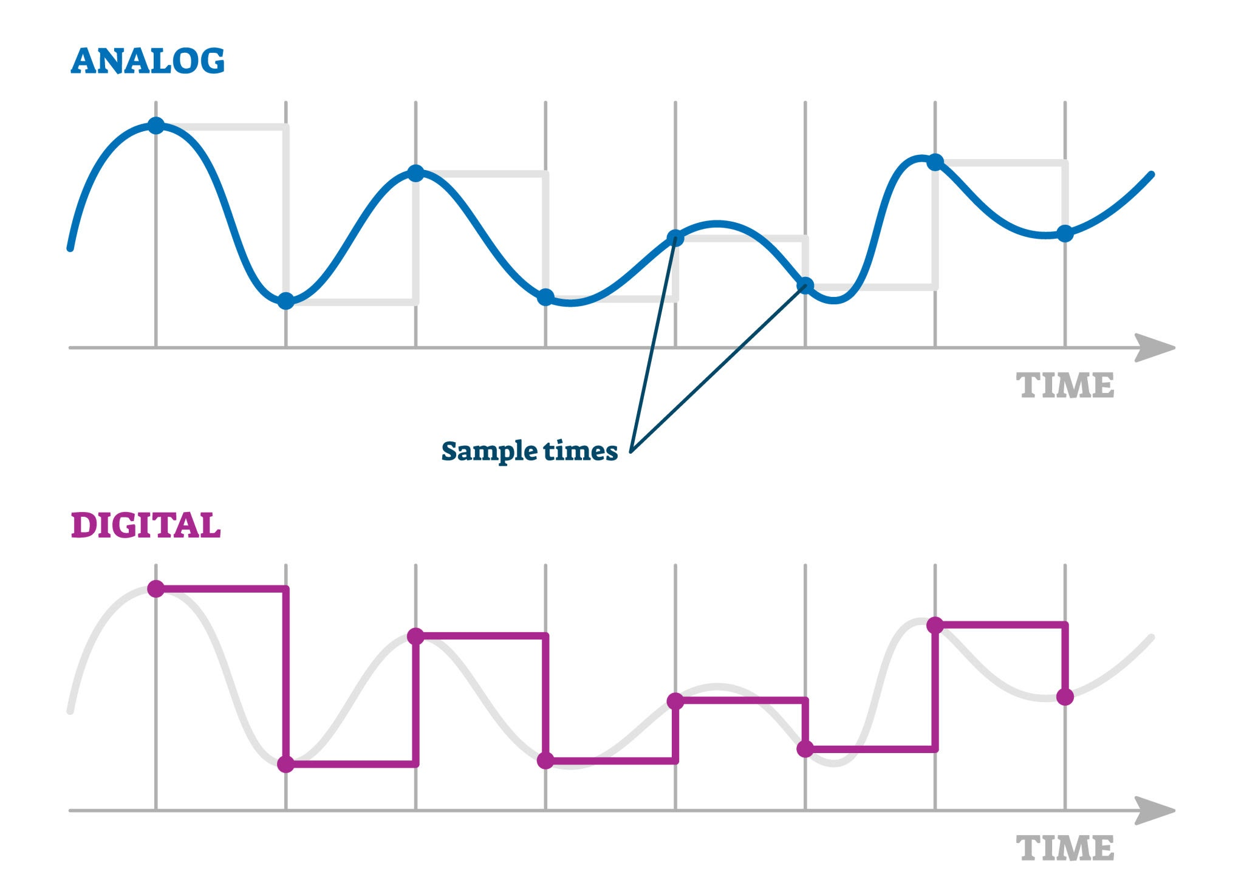
Sensor Interfacing: Analog and Digital Sensors

Slide 4
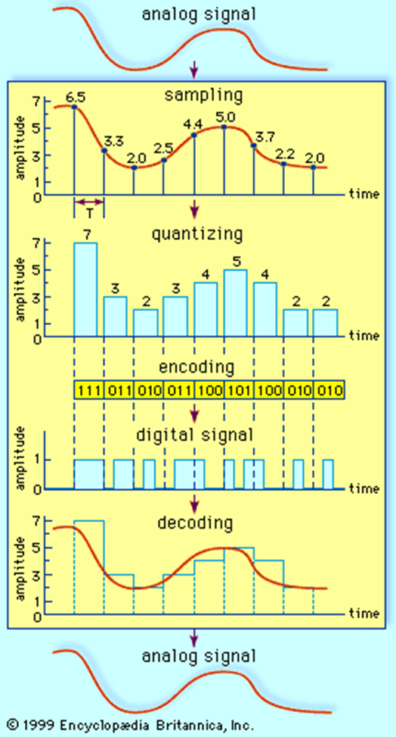
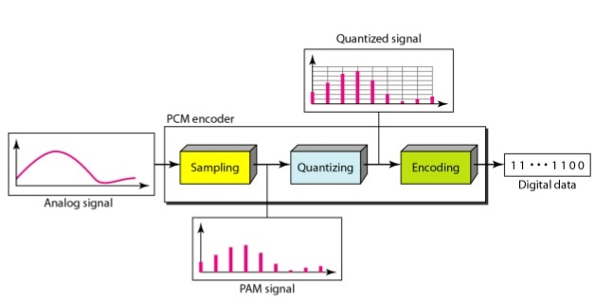
Sensor Interfacing: Analog and Digital Sensors
Analog to Digital Converters

Slide 5
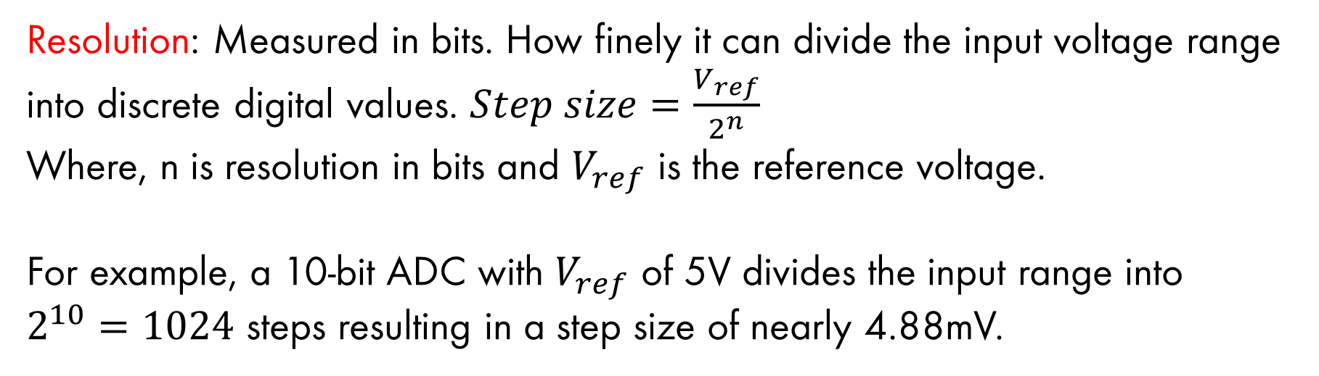
Sensor Interfacing: Analog and Digital Sensors
Analog to Digital Converters
Resolution: Measured in bits. How finely it can divide the input voltage range into discrete digital values. $Step size=\frac{V_{ref}}{2^{n}}$
Where, n is resolution in bits and $V_{ref}$ is the reference voltage.
For example, a 10-bit ADC with $V_{ref}$ of 5V divides the input range into $2^{10}=1024$ steps resulting in a step size of nearly 4.88mV.

Slide 6
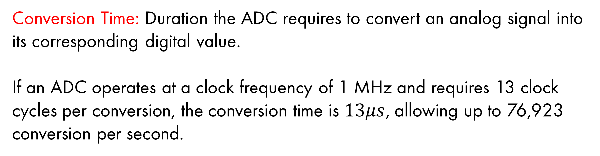
Sensor Interfacing: Analog and Digital Sensors
Analog to Digital Converters
Conversion Time: Duration the ADC requires to convert an analog signal into its corresponding digital value.
If an ADC operates at a clock frequency of 1 MHz and requires 13 clock cycles per conversion, the conversion time is $13μs$, allowing up to 76,923 conversion per second.

Slide 7
Sensor Interfacing: Analog and Digital Sensors
Digital Sensors
Data are converted to digital format with in sensor itself.
High noise immunity.
Easier to transmit over long distances.
Directly compatible with microcontrollers.
MPU6050(Accelerometer)

Slide 8
Sensor Interfacing: Analog and Digital Sensors
Feature | Analog Sensors | Digital Sensors
Output Type | Continuous Voltage/Current | Binary Data/Packets
Microcontroller Pin | Analog Input (ADC) | Digital/Communication Pins
Noise Sensitivity | High | Low
Complexity | Simple hardware, complex code | Complex hardware, simpler code
Cost | Generally Cheaper | Generally, more expensive

Slide 9
Actuator Interfacing
An actuator is a component responsible for moving or controlling a mechanism or system.
Unlike sensors, actuators often require high current/voltage that microcontroller cannot provide directly.
uses power source (electrical, hydraulic)
converts it into mechanical work

Slide 10
Actuator Interfacing
MOTOR
An electric motor converts electrical energy into mechanical energy.
DC Motor: Operates on direct current and produces continuous rotational motion
Stepper Motor: Rotates in discrete steps and position is controlled without feedback
Servo Motor: Provides precise position control and operates using closed loop system

Slide 11
Actuator Interfacing
DC Motor
Converts electrical energy into rotational motion. It operates on a simple principle, when a voltage is applied across its two terminals, the motor produces rotational motion.
By reversing the polarity of the DC voltage the direction of rotation is reversed.
Robotics, computer cooling fans, toys etc

Slide 12
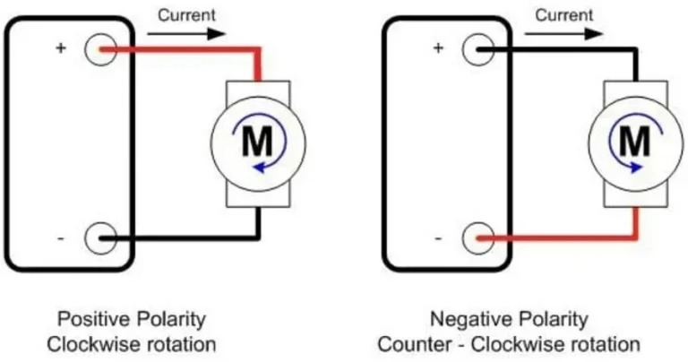
Actuator Interfacing
DC Motor

Slide 13
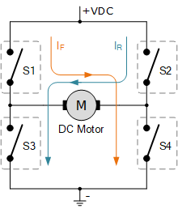
Actuator Interfacing
DC Motor
Relays: Relays can be used to switch the polarity of the power supply.
H-Bridge Circuit: Consists of a combination of transistors or MOSFETs that can reverse the polarity of the voltage applied to the motor. L293D and L298N

Slide 14
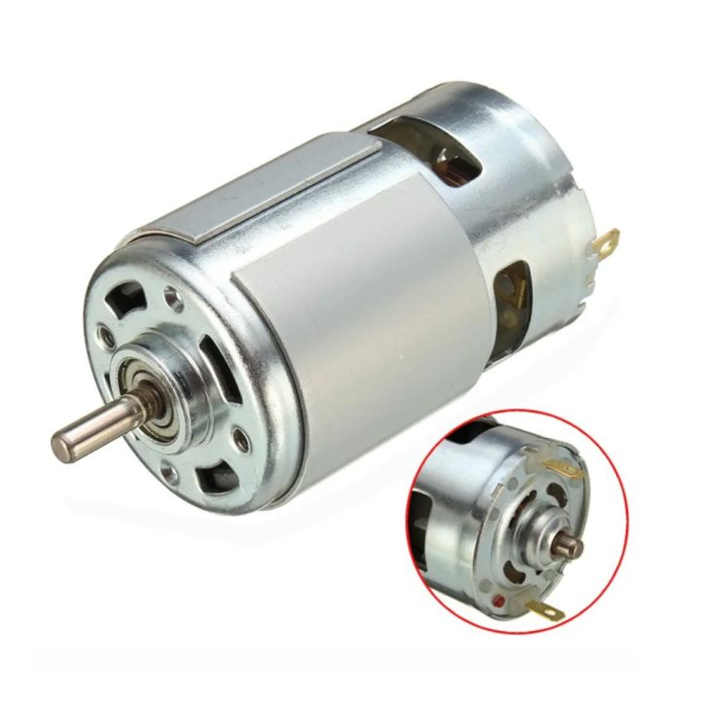
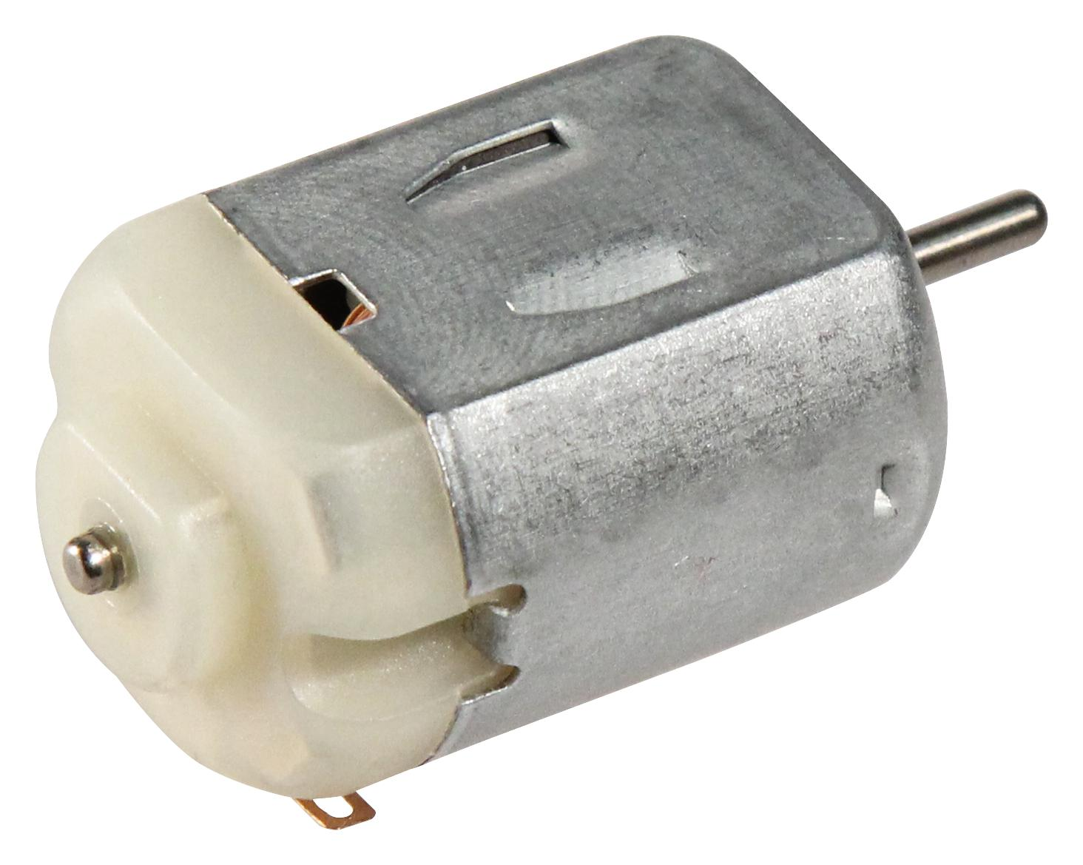
Actuator Interfacing
DC Motor

Slide 15
Actuator Interfacing
Stepper Motor
Converts electrical energy into rotational motion. It is specifically designed to perform precise movements, known as steps, to achieve accurate positioning.
A magnetic field is generated by current flowing in the coil and rotor aligns with this field.
3D printers, CNC machines, robotics

Slide 16
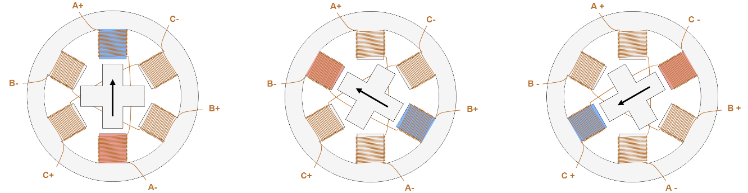
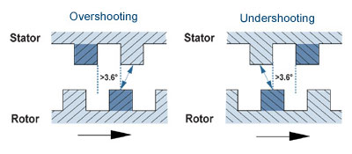
Actuator Interfacing
Stepper Motor

Slide 17
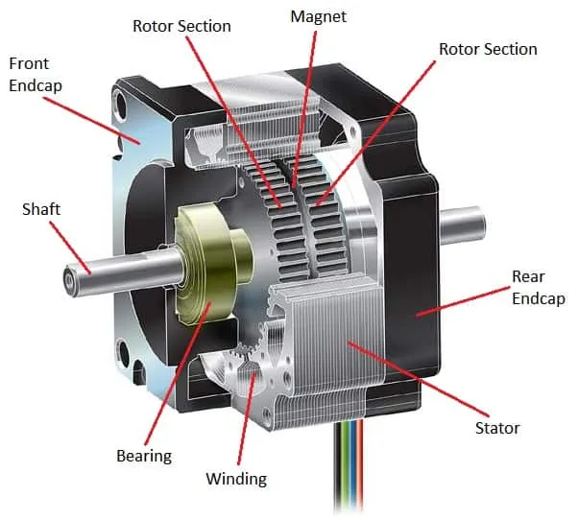
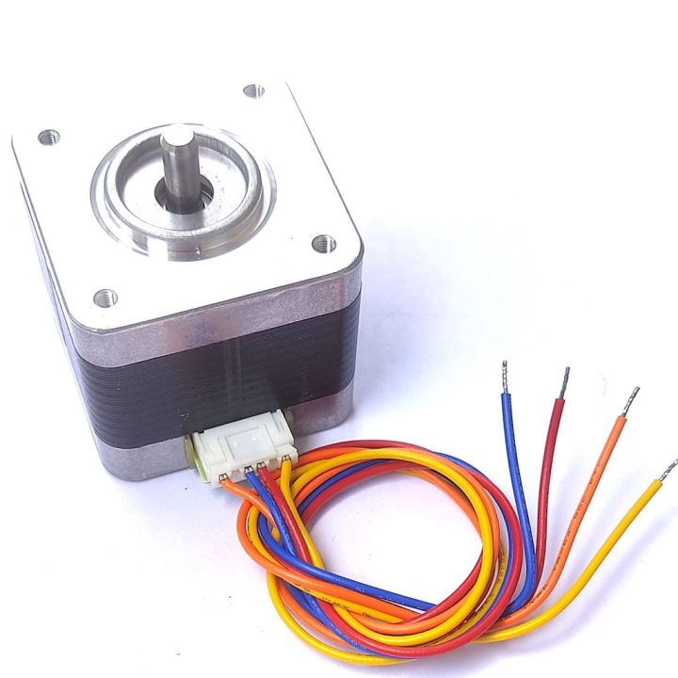
Actuator Interfacing
Stepper Motor

Slide 18
Actuator Interfacing
Servo Motor
A rotary actuator used for precise control of angular position, speed and acceleration.
They have feedback control mechanism that allow them to precisely control position within a closed loop system.
It consists of motor for rotary motion, encoder for signaling angle or displacement of motor, driver for powering the motor with feedback and gears for additional torque.

Slide 19
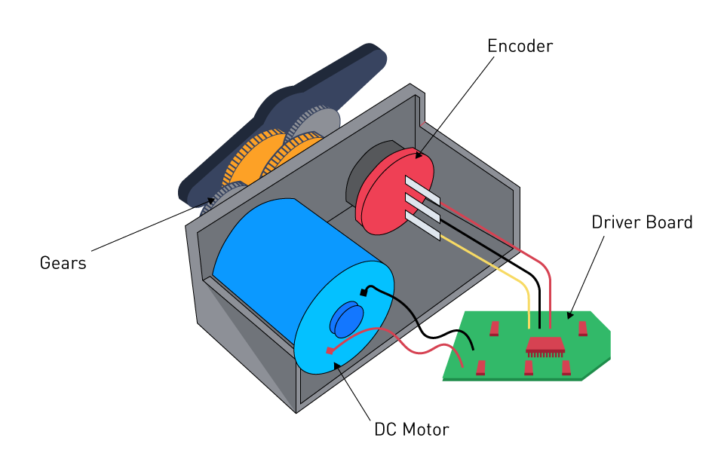
Actuator Interfacing
Servo Motor

Slide 20
Actuator Interfacing
Operating modes
Speed Control: Maintain a set speed despite changing load circumstances. Eg: conveyor belts
Torque Control: Maintain steady torque when continuous force is required. Eg: pressing or winding application
Position Control: Precisely regulate position is their most prevalent and distinctive characteristic. Eg: CNC machines, Robotics

Slide 21
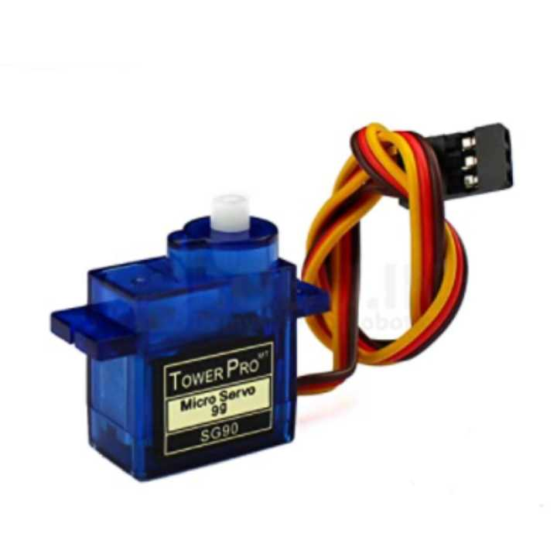
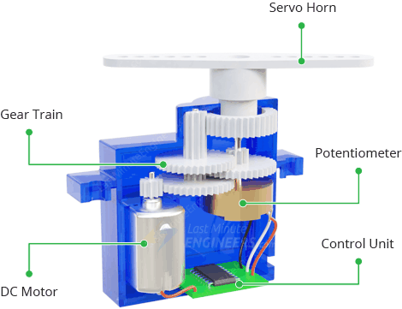
Actuator Interfacing
Servo Motors

Slide 22
Actuator Interfacing
PWM (Pulse Width Modulation)
PWM is a technique for getting analog results with digital means. The duration of “on time” is called the pulse width.
Digital control is used to create square wave, a signal switched between on and off.
By changing the on-off pattern, we can simulate voltages in between the full Vcc of the board.

Slide 23
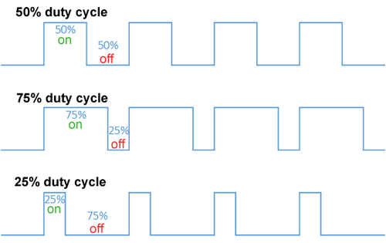
Actuator Interfacing
PWM (Pulse Width Modulation)

Slide 24
Display Interfacing
Seven Segment Display
The display consists of seven LED segments arranged in a rectangular pattern, with an additional dot segment.
Common Cathode: All the cathode terminals of the LEDs are connected together to a common ground. The individual segment is lit up by supplying high voltage.
Common Anode: All the anode terminals of the LEDs are connected together to a high voltage. The individual segment is lit up by supplying ground.

Slide 25
Display Interfacing
Seven Segment Display
a
a
a
a
a
f
b
f
b
f
b
f
b
f
b
g
g
g
g
g
e
c
e
c
e
c
e
c
e
c
d
d
d
d
d
For 0
For 1
For 2
For 3
For 4
a
a
a
a
a
b
b
b
b
b
f
b
f
b
f
b
f
f
g
g
g
g
g
e
c
e
c
e
c
e
c
e
c
d
d
d
d
d
For 5
For 6
For 7
For 8
For 9

Slide 26
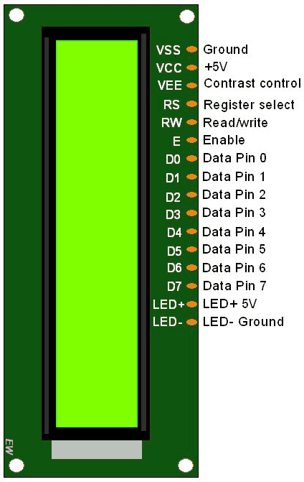
Display Interfacing
LCD $16×2$ Display
Dot-matrix character LCDs are particularly popular in embedded systems due to their simplicity and functionality.
PIN 1(GND) and PIN 2 (Vcc): These are for power supply connections.
PIN 3(Vee): This pin adjusts the display contrast. Connecting it to GND provides maximum contrast.
PIN 4 (RS): Register select must be 0 for command and 1 for data to be displayed.

Slide 27
Display Interfacing
LCD $16×2$ Display
PIN 5 (RW): 0 is used to write data to LCD and 1 for reading data from LCD.
PIN 6(E): The high to low pulse is required to register data.
PIN 7 to 14 (D0 to D7): These pins serve as the parallel data/command interface.
PIN 15 and 16 (LED+ and LED-): These provide power to the backlight.

Slide 28
Display Interfacing
LCD $16×2$ Display
Command (Hex) | Action | Description
0x01 | Clear Display | Clears the entire screen and returns cursor to home (top left).
0x02 | Return Home | Returns cursor to (0,0) without clearing the display contents.
0x04 | Decrement Cursor | Cursor moves left after each character (Shift Off).
0x06 | Increment Cursor | Cursor moves right after each character (Standard Entry Mode).
0x0C | Display ON, Cursor OFF | Shows text but hides the underline/blinking cursor.
0x0E | Display ON, Cursor ON | Shows text and an underline cursor.
0x0F | Display ON, Blinking | Shows text with a blinking block cursor.
0x10 | Shift Cursor Left | Moves the cursor position one step to the left.
0x14 | Shift Cursor Right | Moves the cursor position one step to the right.
0x18 | Shift Entire Display Left | Scrolls all text on the screen one step to the left.
0x1C | Shift Entire Display Right | Scrolls all text on the screen one step to the right.
0x80 | Force Cursor to Line 1 | Moves cursor to the start of the first row.
0xC0 | Force Cursor to Line 2 | Moves cursor to the start of the second row.
0x28 | 4-bit / 2-line Mode | Initializes the LCD in 4-bit mode with 5x8 pixel font.
0x38 | 8-bit / 2-line Mode | Initializes the LCD in 8-bit mode with 5x8 pixel font.

